Slide 1

EDA of Summer Olympics

Slide 2
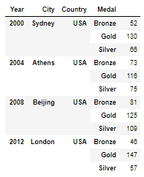
Which Country scored highest number of medals in the last 4 Olympics?
USA has secured highest number of total medals in the last 4 Olympic seasons.

Slide 3
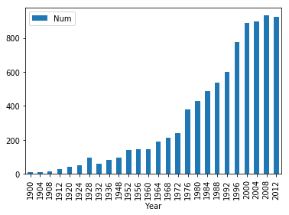
How is the participation of women in Olympics?
Women participation has increased exponentially from the initial Olympic seasons.

Slide 4
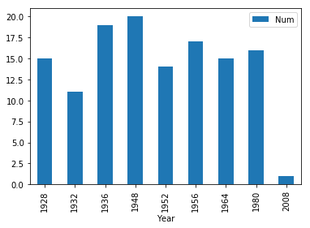
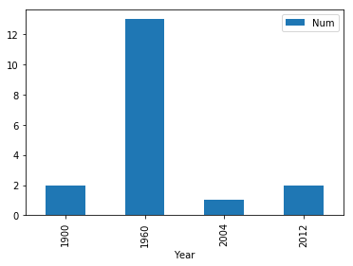
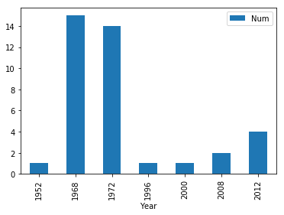
How is the performance of India in Olympics?
GOLD
SILVER
BRONZE
The above graphs indicates the number of Gold, Silver and Bronze medals India won in Olympics

Slide 5
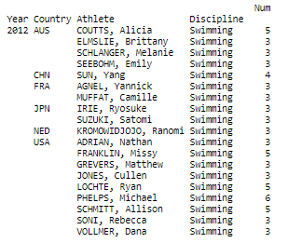
How many athletes won more than 2 medals, in Swimming?
The above table tells us about the athletes who have won more than 2 medals in Swimming at 2012 Summer Olympics.

Slide 6
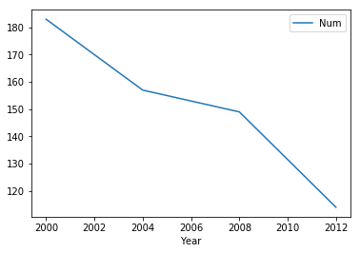
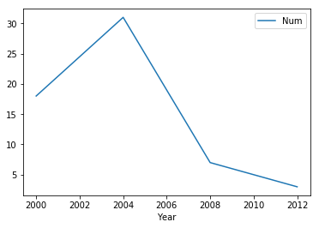
How does the City hosting the Olympics games impact the Home Country's performance?
AUSTRALIA medals – hosted in Sydney during 2000
GREECE medals – hosted in Athens during 2004
The above graphs indicates how the Country's performance is higher when played in their home grounds when compared to playing outside the country.

Slide 7
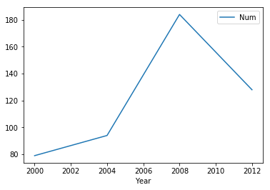
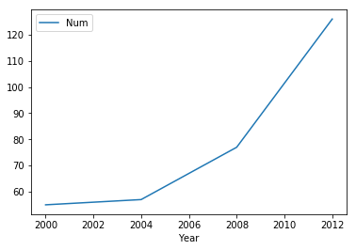
CHINA medals – hosted in Beijing during 2008
Great Britain medals – hosted in London during 2012
As an extension of the previous slide, the above given graphs display how the medal counts are higher when played in their home grounds.

